Slide 1
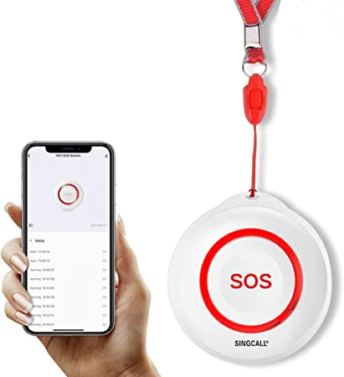
Prepared By: Ankur Kushwaha Prahlad Roy Pareek Pankaj Patel Pooja Tailor Aerika Modi Heer Vankawala
Fall Detection Recognition Systems

Slide 2
Process Model and Safety Standards
Rational Unified Process Model
IEC61508 Safety Standard -- Ensures that our software meet IEC61508 safety standards

Slide 3

Why Rational Unified Process Model ?
A process for developing object-oriented software is called Rational Unified Process (RUP)
An Iterative Process for Projects
RUP provides a systematic approach to allocating and managing activities and responsibilities within a development organization by segmenting the project life cycle into several phases.
Software developers can deal with varying needs from clients or the project itself
RUP emphasizes the significance of accurate documentation as well. It also boosts software engineers' productivity

Slide 4
Steps in our (U) Process Model
Here are the steps which will be implemented in each iteration .
Requirement Analysis
Design and Implementation ( Use case diagram)
Coding
Testing ( Integration Testing , System testing)
Deployment
IEC61508 Safety Standard -- Ensures that our software meet IEC61508 safety standards

Slide 5
Iterative Process Development
Every Development process in each iteration will take two weeks to complete .
Development will be completed in three iterations .
In each iteration software will be tested, integrated and deployed .
Unified Process Model
Iteration 2
Iteration 3
Iteration 1

Slide 6
Implementation of IEC 61508 Safety Standards
Hazard and Risk Analysis must be done
Specify Safety Requirements during analysis phase of our fall detection project.
Safety validation of fall detection system must be done
Operation and maintenance of the systems
Achieving functional safety and managing risk

Slide 7
Requirement Analysis
Fall Detection using sensors.
Alarm Notification should be sent to user
Alert Emergency Services
Hardware and Software Requirements
Android Phone or Simulator
Data Aggregator
MATLAB
Android Studio
Accelerometers

Slide 8
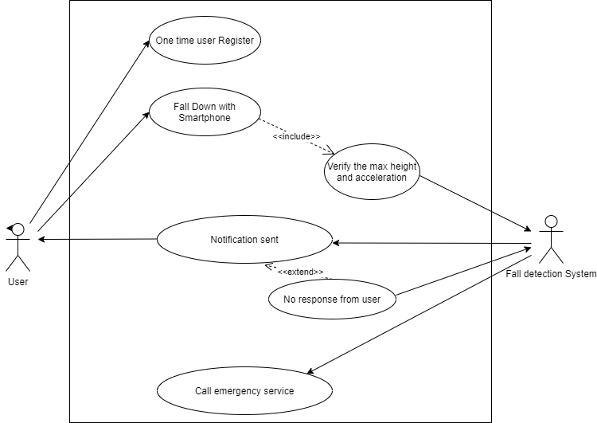
Design and Implementation
Use case diagram of fall detection system

Slide 9
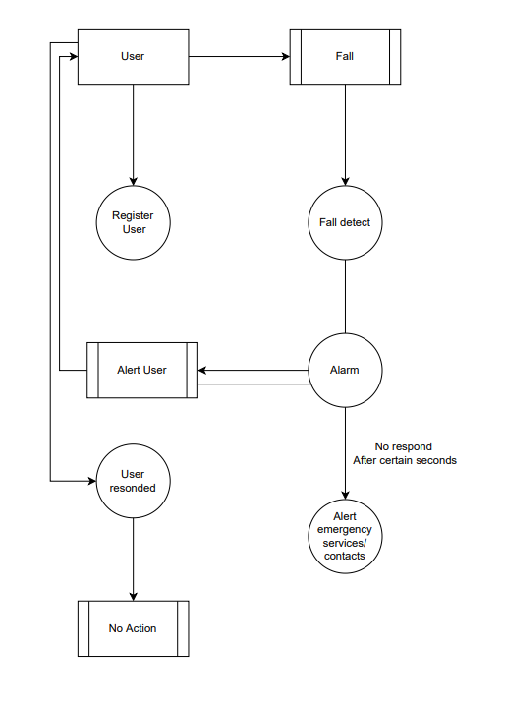
Data Flow Diagram
As shown in data flow diagram first our user must register one time and listed his information etc. blood type and emergency contacts.
Whenever our application detects any fall using Android sensers it will send alarm to user for certain seconds if user respond during that time no actions will be taken but if User don’t respond then Application will Alert emergency services and contacts

Slide 10
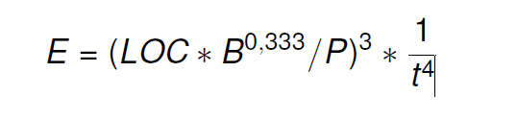
Estimation Calculation
E = Effort in person months
t= project durations
B(Special Skill Factors)=?
P(Productive Parameters)=?

Slide 11
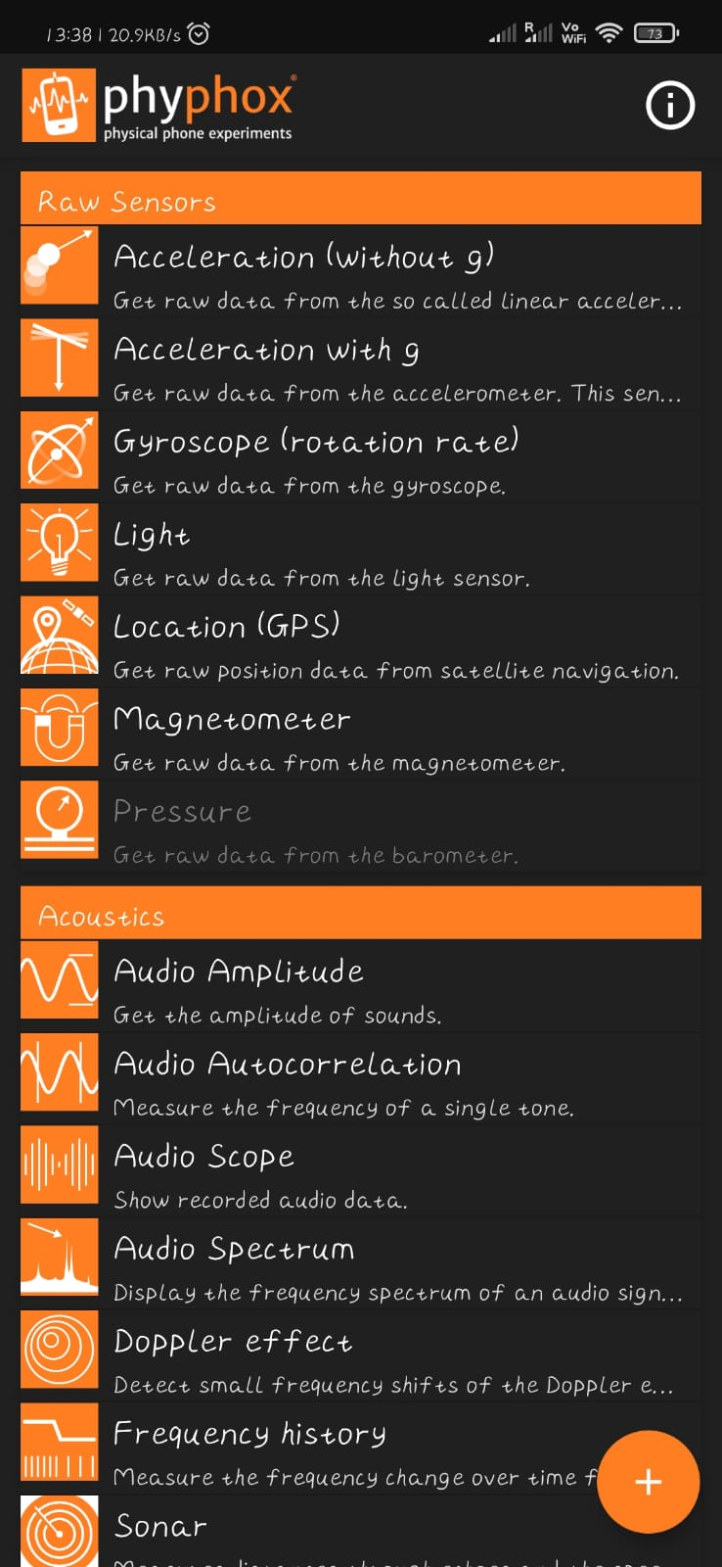
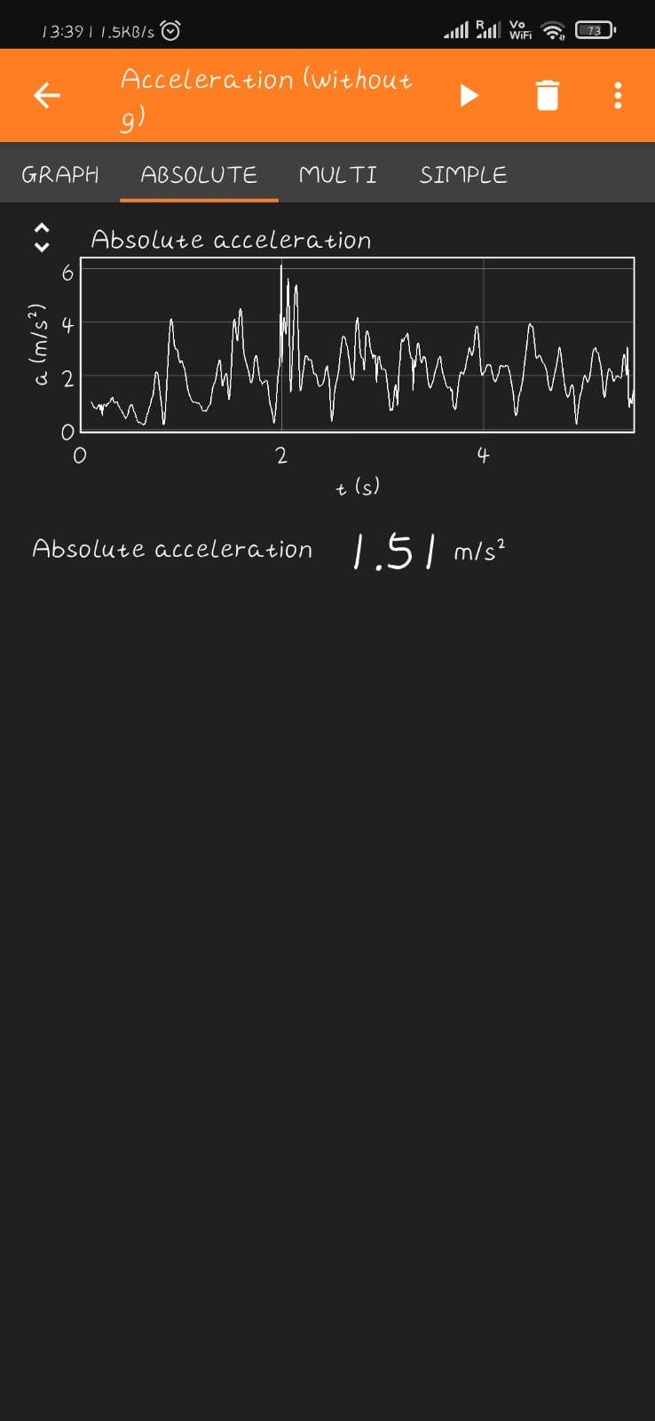
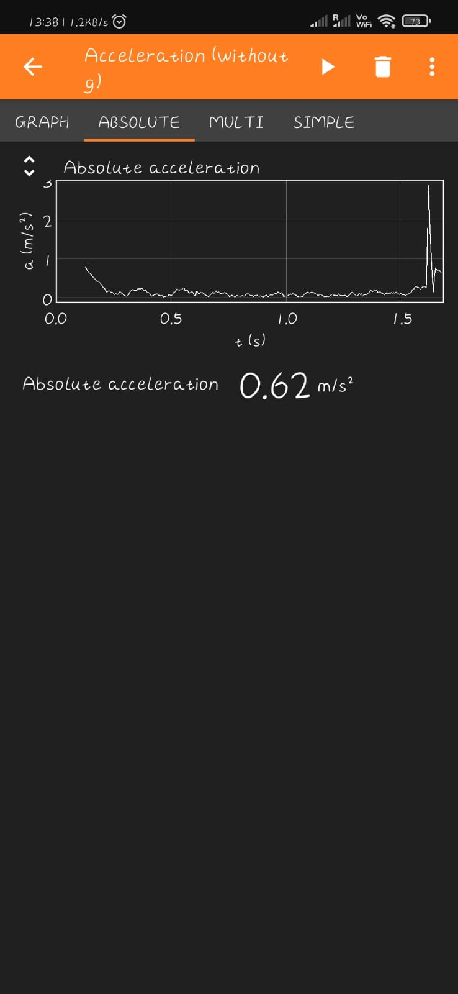

Slide 12
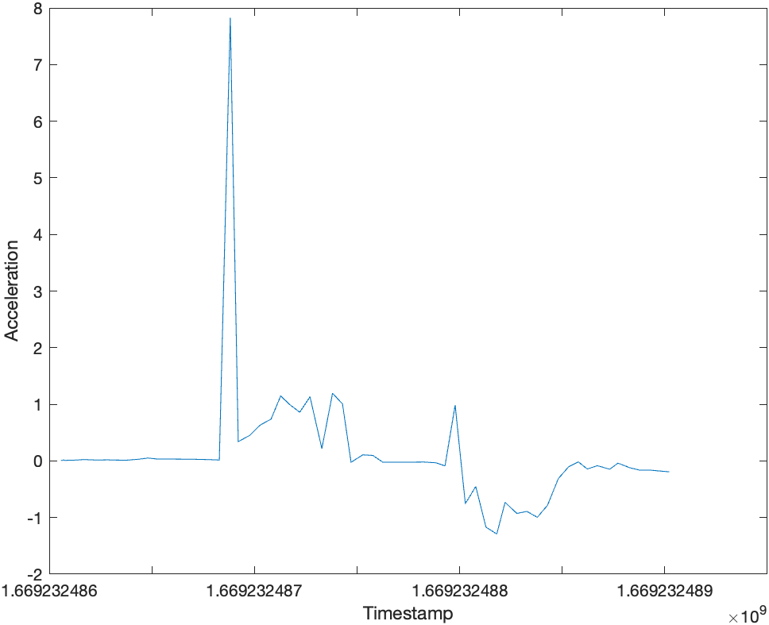
Accelerometer Implementation

